Slide 1



NORMALIZED CUTS AND IMAGE SEGMENTATION
Naveen k-CB.SC.U4AIE24235
Subash B-CB.SC.U4AIE24254
Sai Kushal B-CB.SC.U4AIE24252
Cibi Kumar-CB.SC.U4AIE24212

Slide 2
INTRODUCTION
Image segmentation is the process of dividing an image into meaningful regions.
Goal:
Identify objects
Separate foreground and background
Understand scene structure
Applications:
Medical imaging
Autonomous driving
Object detection
Image compression

Slide 3
PROBLEM WITH TRADITIONAL SEGMENTATION
Traditional segmentation methods focus on local features such as:
Edges
Color similarity
Texture
Limitations:
Cannot capture global structure
Sensitive to noise
Often produce fragmented segments

Slide 4
MAIN IDEA OF THE PROJECT
The image is represented as a graph.
Graph:
G=(V,E) Where:
V = set of nodes (pixels)
E = edges connecting pixels
Each edge has a weight representing similarity between pixels.
Goal:
Split the graph into groups such that
similarity within groups is high
similarity between groups is low

Slide 5
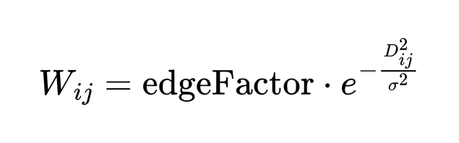
WEIGHT MATRIX USING EDGE WEIGHTS
Similarity between two pixels i and j is defined as
Where:
Wij​ → similarity between nodes
Dij → distance between feature vectors
σ → scaling parameter controlling similarity decay
edgeFactor → additional weight (often used for boundary/edge emphasis)
Interpretation
If two pixels are similar → Dij small → weight ≈ high
If two pixels are very different → Dij​ large → weight ≈ close to 0

Slide 6
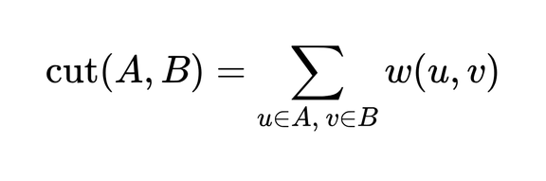
MINIMUM CUT
The cost of separating the graph is called cut
Where:
w(u,v) = similarity between nodes u and v.
The formula sums all weights connecting nodes in A to nodes in B.

Slide 7
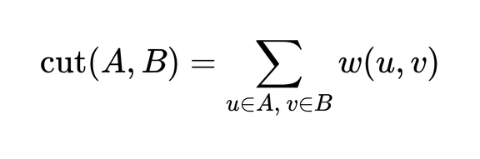
MINIMUM CUT EXAMPLE
Example Graph
Suppose we have 4 nodes.
Group A = {1,2}
Group B = {3,4}
Edge weights:
1 → 3 = 2
1 → 4 = 1
2 → 3 = 3
2 → 4 = 2
Calculation
cut(A,B) = 2 + 1 + 3 + 2
cut(A,B) = 8
Meaning
Cut value measures the total similarity between two groups.

Slide 8
PROBLEM WITH MINIMUM CUT
Minimum cut often gives bad segmentation.
Example:
Instead of separating objects, it may isolate small pixel groups.
Reason:
Cut value becomes small when few edges are removed.
Therefore the partition becomes unbalanced.

Slide 9
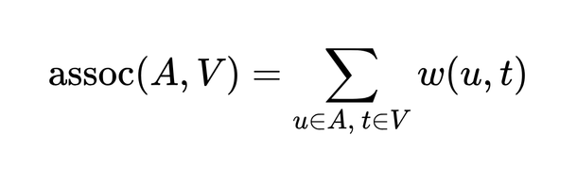

ASSOCIATION FORMULA
To fix minimum cut problem, we measure association.
Explanation:
This calculates the total connection of nodes in A to the entire graph.
Similarly:
is the total connection of B to all nodes.
This helps measure how strongly a group is connected.

Slide 10
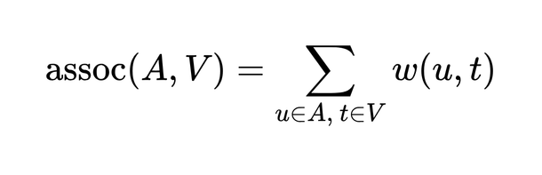
ASSOCIATION EXAMPLE
Example
Group A = {1,2}
Connections:
1 → 2 = 4
1 → 3 = 2
1 → 4 = 1
2 → 3 = 3
2 → 4 = 2
Calculation
assoc(A,V) = 4 + 2 + 1 + 3 + 2
assoc(A,V) = 12
Meaning
Association measures how strongly a group is connected to the entire graph.

Slide 11
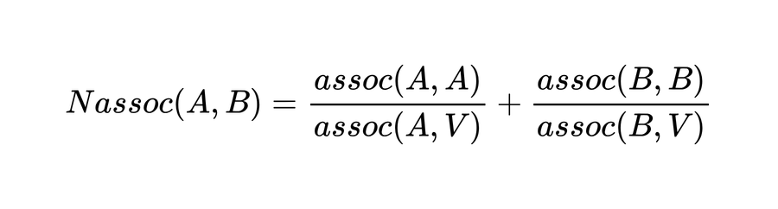
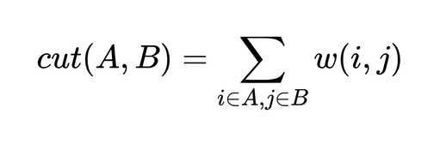
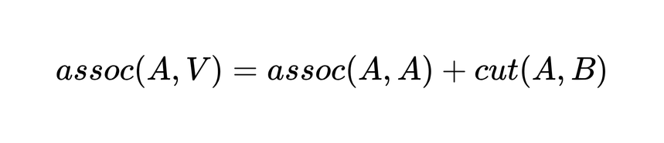
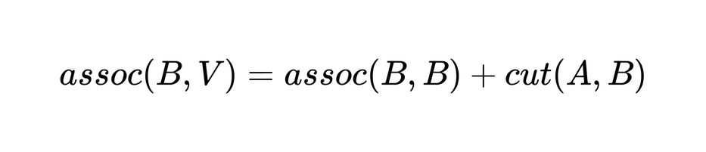
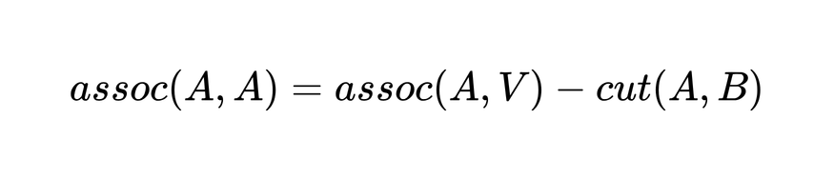
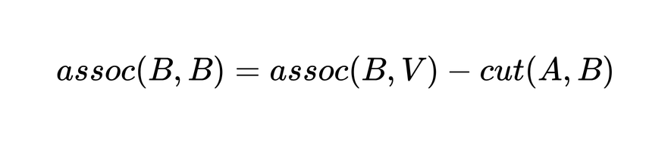
NORMALIZED ASSOCIATION
Normalized Association measures how strongly nodes within the same group are connected.

Slide 12
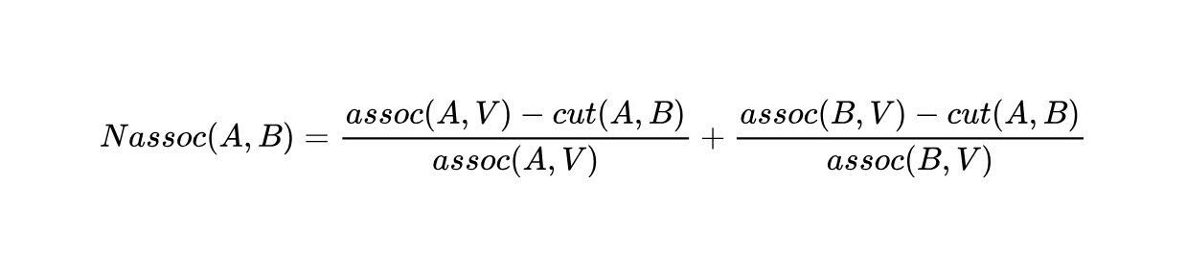
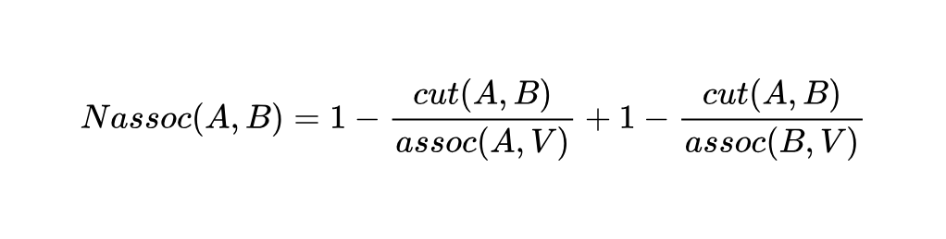
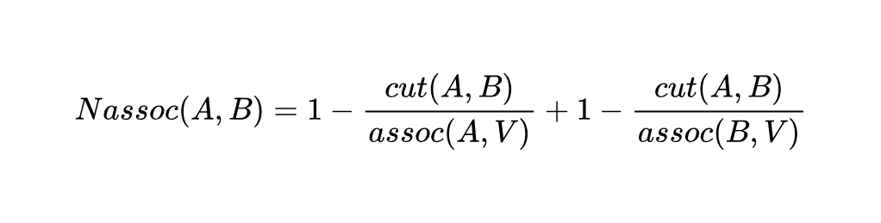
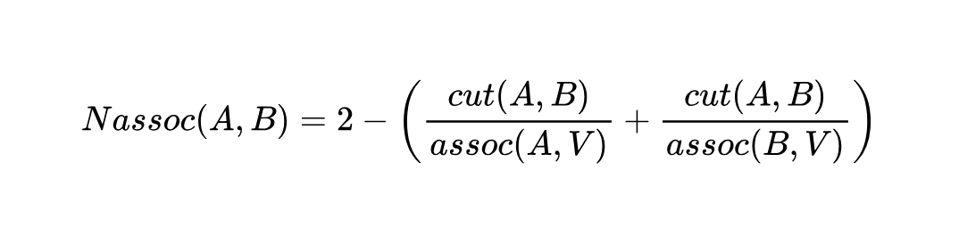
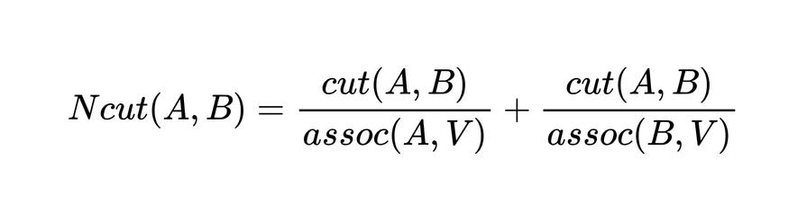
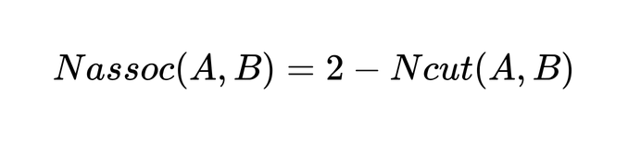

Slide 13
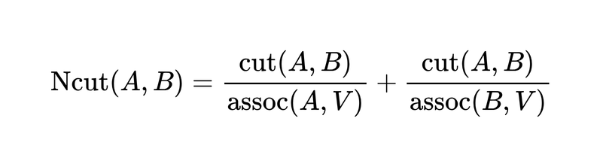
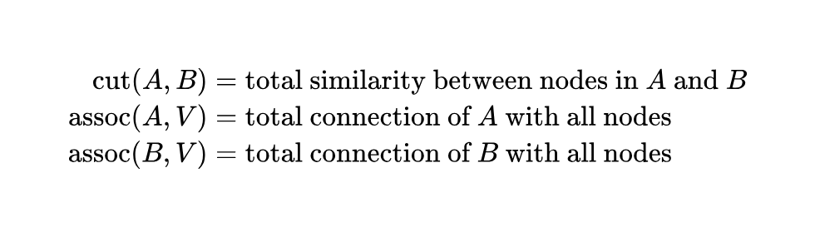
NORMALIZED CUT FORMULA
Normalized Cut measures the quality of graph partitioning by considering both:
• Dissimilarity between groups
• Similarity within groups
Where:

Slide 14
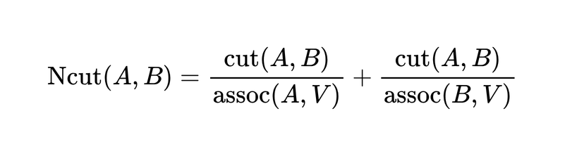
NORMALIZED CUT EXAMPLE
Example of a Good Cut
cut(A,B) = 3
assoc(A,V) = 12
assoc(B,V) = 14
Calculation
Ncut = 3/12 + 3/14
Ncut = 0.25 + 0.214
Ncut ≈ 0.464
Interpretation
Smaller Ncut → Better segmentation
Groups are weakly connected to each other
Nodes inside each group are strongly connected
Example of a Bad Cut
cut(A,B) = 10
assoc(A,V) = 12
assoc(B,V) = 14
Calculation
Ncut = 10/12 + 10/14
Ncut = 0.833 + 0.714
Ncut ≈ 1.547
Interpretation
Larger Ncut → Poor segmentation
Many strong connections exist between groups
The partition does not separate the graph well

Slide 15
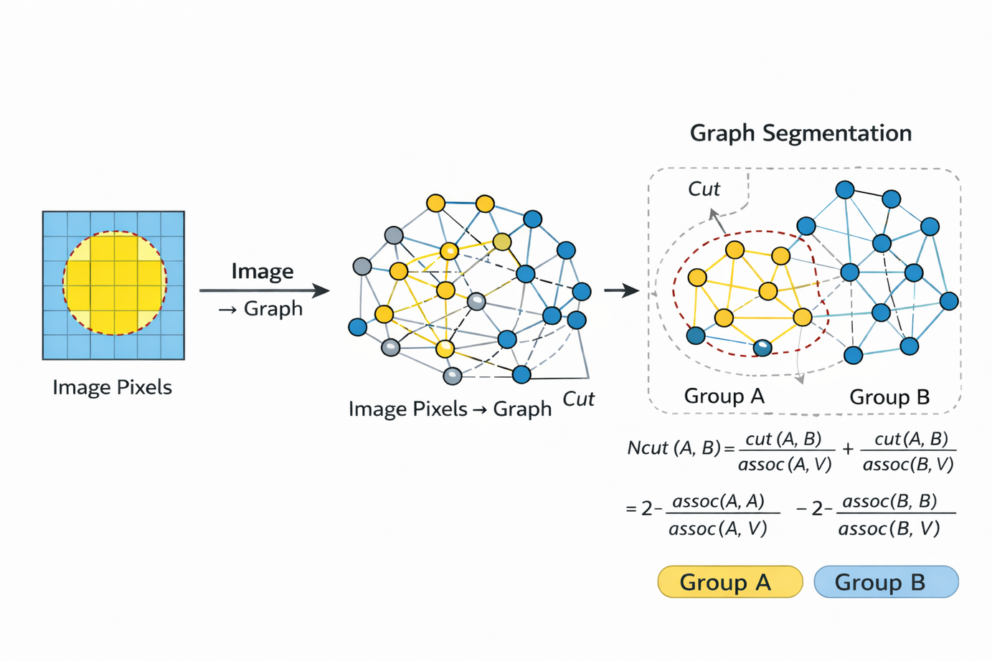
NORMALIZED CUT

Slide 16
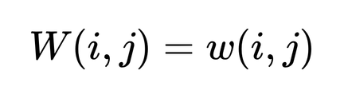
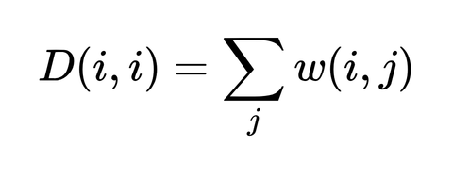
MATRIX REPRESENTATION
To solve the Ncut problem we represent the graph using matrices
Weight Matrix:
Degree Matrix:

Slide 17
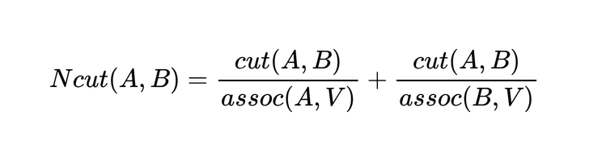
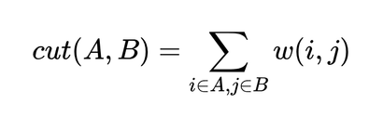
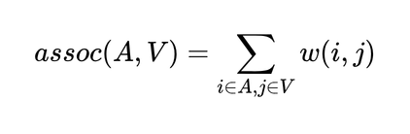
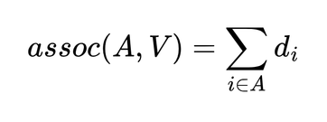
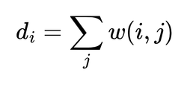
RAYLEIGH QUOTIENT FORMATION
For graph G=(V,E) divided into sets A and B:

Slide 18
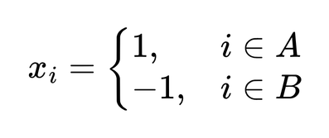
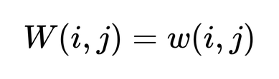
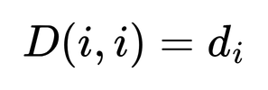
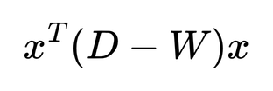
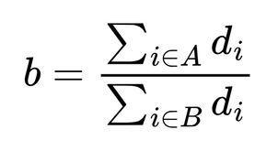
Partitioning Is Discrete
We must decide which node goes into A or B.
This is a combinatorial problem (NP-complete).
So we will convect to vector form
Express Cut Using Matrix Form
Important identity

Slide 19
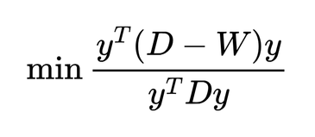
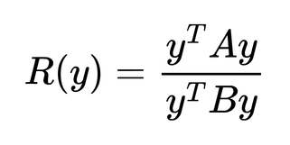


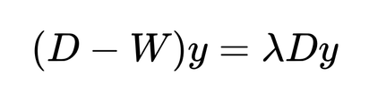

Slide 20
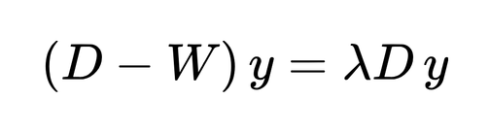
EIGENVALUE PROBLEM
The Ncut optimization becomes:
Where
W = similarity matrix
D = degree matrix
y = eigenvector
λ = eigenvalue
By solving this generalized eigenvalue problem, we obtain the optimal partition.

Slide 21
WHY SECOND EIGENVECTOR
The smallest eigenvector corresponds to trivial solution.
So we use the second smallest eigenvector
This eigenvector gives the best partition of the graph.
We split nodes based on positive and negative values of eigenvector.

Slide 22
ALGORITHM STEPS
Normalized Cuts Algorithm:
Construct weighted graph from image
Compute similarity matrix W
Compute degree matrix D
Solve eigenvalue problem
Use second eigenvector to split graph

Slide 23
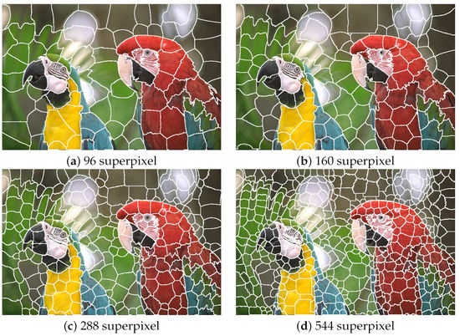
SUPERPIXELS
Superpixels group similar neighboring pixels into small regions before segmentation.
Instead of treating every pixel as a node in the graph, each superpixel becomes a node, which reduces the graph size and speeds up computation.
Example:
Image (512 × 512 pixels) → 262,144 pixels
After superpixels → ~500–1000 regions
In our implementation, superpixels help:
Reduce computational complexity
Preserve object boundaries
Make Normalized Cut segmentation faster
Superpixels are commonly generated using the SLIC algorithm.

Slide 24
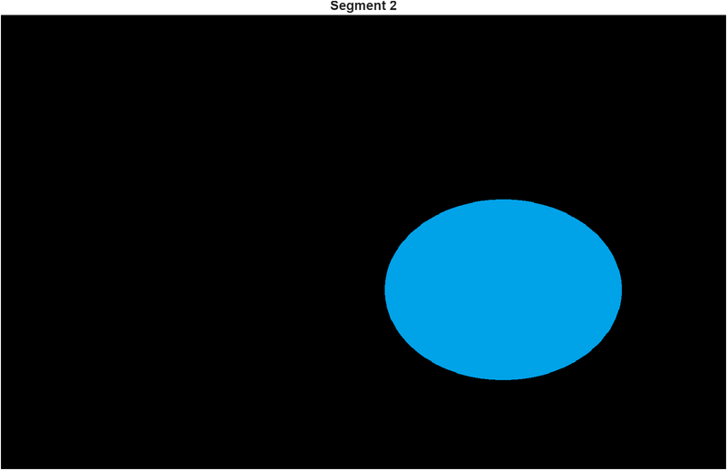

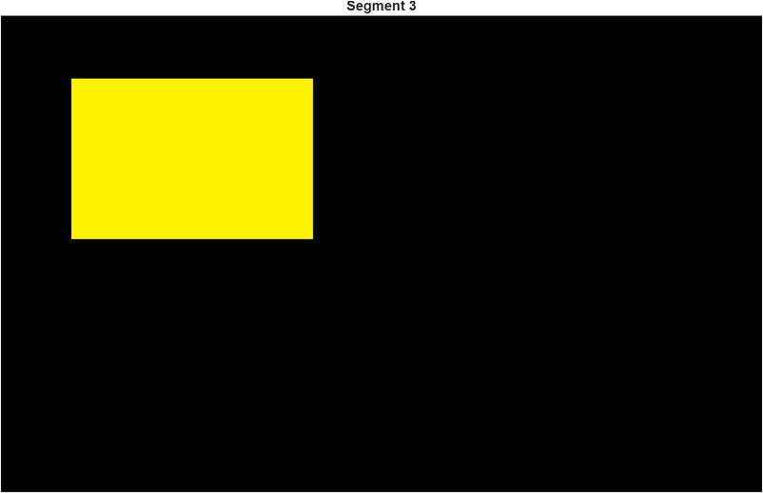
SEGMENTATION RESULTS
Segment 1
Original image
Segment 2

Slide 25
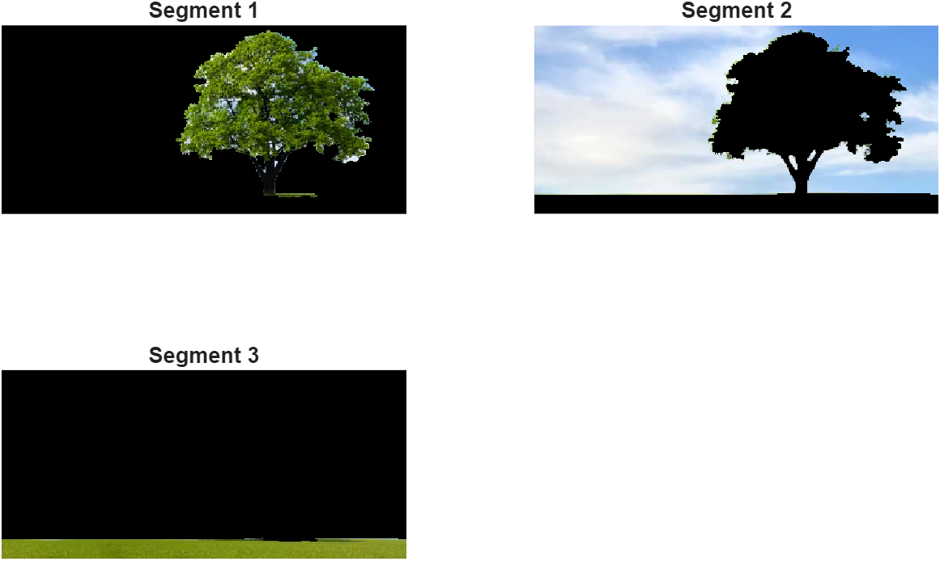

SEGMENTATION RESULTS

Slide 26



SEGMENTATION RESULTS
Original image
Segment 1
Segment 2

Slide 27
ADVANTAGES
Uses global information
Avoids small isolated segments
Works for color, texture, motion
Produces balanced segmentation

Slide 28
CONCLUSION
Normalized Cuts is a spectral graph theory approach for segmentation.
Key contributions:
global segmentation method
balanced partitions
eigenvector based solution

Slide 29
THANK YOU

